Slide 1

Wireframe Document
MBS Build on You project
Contents:
Itemised overview of changes
Outstanding questions after wireframing
Visual overview of changes
Phase 2 changes
Phase 3 changes
Client: Melbourne Business School
Version: v1.2
Ref: #0013
File: MBS_Report_v1.2
Date: 21-03-2022

Slide 2
Itemised overview of changes
Phase / Task | Description | Questions
2.1 | Number unique enrolments. Redesign/new Graphic for the ‘Enrolment by date’ page
2.1 | Change Enrolment by APS level from one donut chart to two – 1 for APS level and 1 for Military level. This will pull data from separate colums in the current Enrolment_Data CSV Column AK: aps_level Column AL: military_rank
2.2 | Add date filter if possible | *
2.3 | Add a filter to this? Ie. Look at group/level by location (NEW)
2.3 | Build a ‘heat map’ of activity
3.1 | Change layout to be similar to DLB excel dashboard, linked here, will also attach file to email (NEW) | *
3.4 | Self-Paced Content Engagement (page 4 of report) Build new section to show Module Content Survery Data File linked here and will be attached to email Please show Course, Module Name, No. Responses and Mean Rating
3.5 | In Program Build Status (page 2 of report) Add field for “Expected Due Date” for topics currently in Planning/Development

Slide 3
Questions
# | Power BI tab | Task | Question
1 | Engagement | Task 2.2 Add date filter if possible (NEW) | Where will the date data to filter on come from? The FSB data which drives the visuals displayed here doesn’t appear to come with date data.
2 | Engagement | Task 3.1 Change layout to be similar to DLB excel dashboard | It looks like the "Raw DaTA" tab of BoY Weekly Dashboard is found by combining the Zoom_Poll_Template.csv & Zoom_Attendance.csv data and creating some calculated fields. It doesn't seem like there's anything on the Zoom_Poll_Template.csv data to connect the Topic feedback given to a particular Topic session given in Zoom_Attendance.csv. For example, if Zoom_Poll_Template.csv has data given on a Topic == 'Mindfulness', and if Zoom_Attendance.csv has had three meetings on Topic == 'Mindfulness', how do you know which meeting the Zoom_Poll_Template relates to? Relating the two csv’s might be achieved by: Aggregating all poll data to a single Mean Score and similarly sum all attendances so that we have one value for each, per month. Attach the same 'Meeting ID' given in Zoom_Attendance.csv to the Zoom_Poll_Template.csv data so that Mean Score can be found per session.

Slide 4
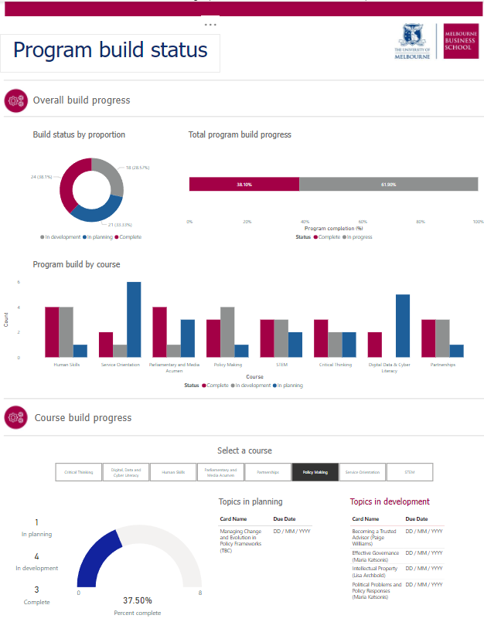
Overview of changes
Task 3.5
Add field for “Expected Due Date” for topics currently in planning/development

Slide 5
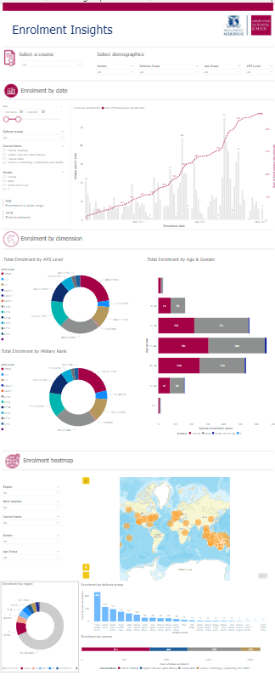
Overview of changes
Task 2.1
New Graphic for the ‘Enrolment by date’ page
Task 2.1
Unique enrolments sorted by Defence Group
Unique enrolments sorted by FFC stream/ course titles (eg. Critical thinking)
Task 2.3
Add a filter to this I.e. Look at group/level by location
Build a ‘heat map’ of activity
Task 2.1
Change Enrolment by APS level from one donut chart to two – 1 for APS level and 1 for Military level.
Task 2.3
Add a filter to this I.e. Look at group/level by location

Slide 6
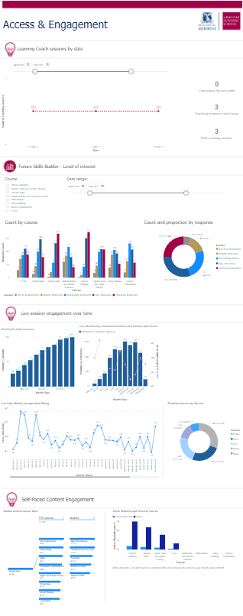
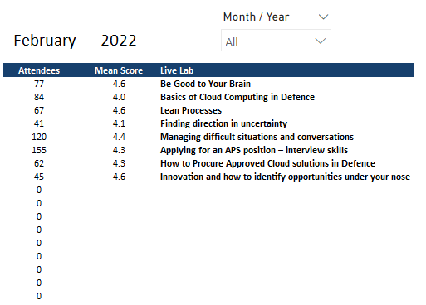
Overview of changes
*
1
Task 2.2
Add date filter if possible (NEW)
Task 2.2
Responses to be reordered to: Not at all > Slightly > Moderately > Very > Extremely
2
*
Task 3.1
Change layout to be similar to DLB excel dashboard
Task 3.4
Build new section to show Module Content Survey Data
Task 3.4
Show Course & Module Name
Task 3.4
Show Mean Rating
Task 3.4
No. of Responses

Slide 7
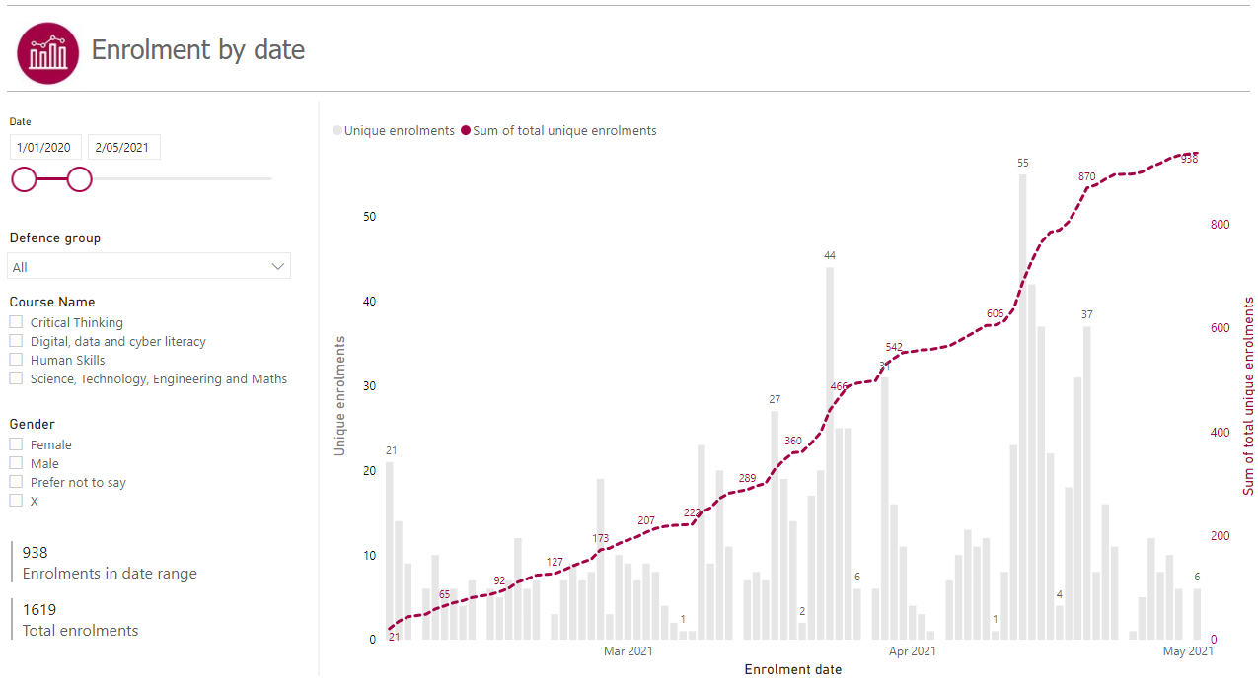
Phase 2 – MBS Build on You
Task 2.1
New Graphic for the ‘Enrolment by date’ page
Task 2.1
Unique enrolments sorted by Defence Group
Unique enrolments sorted by FFC stream/ course titles (eg. Critical thinking)

Slide 8
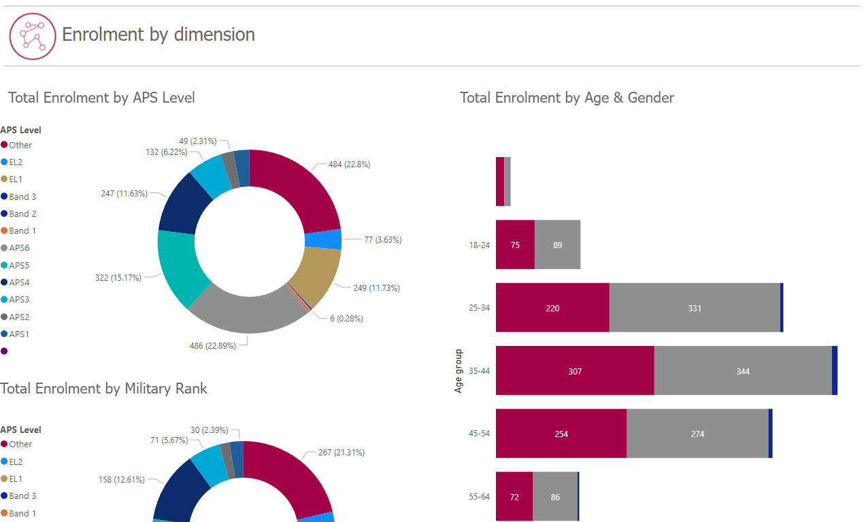
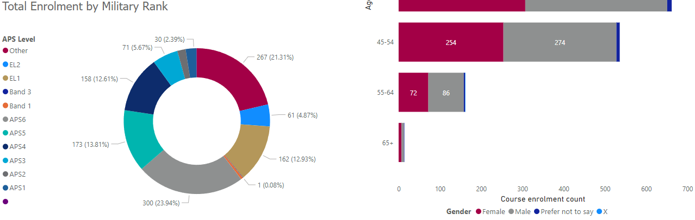
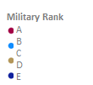
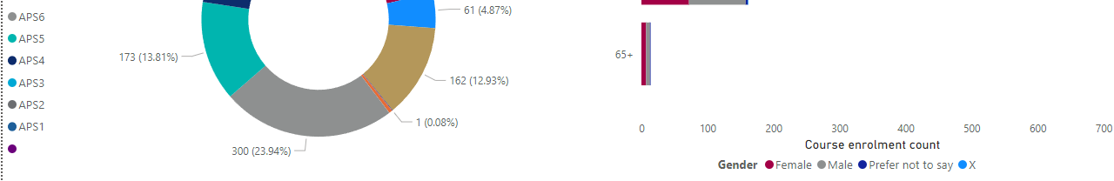
Phase 2 – MBS Build on You
Source: Enrolment_Data.csv aps_level
Source: Enrolment_Data.csv military_rank
…
Task 2.1
Change Enrolment by APS level from one donut chart to two – 1 for APS level and 1 for Military level.

Slide 9
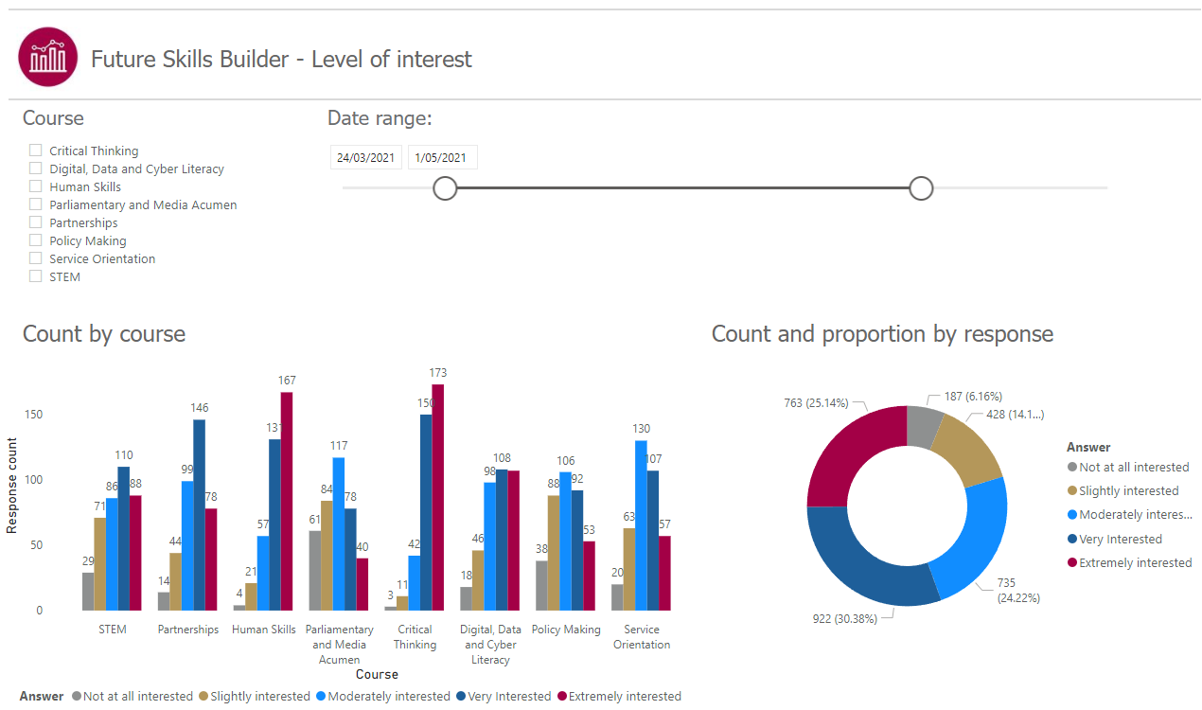
Phase 2 – MBS Build on You
1
*
Task 2.2
Add date filter if possible (NEW)
Task 2.2
Responses to be reordered to: Not at all > Slightly .. Etc.

Slide 10
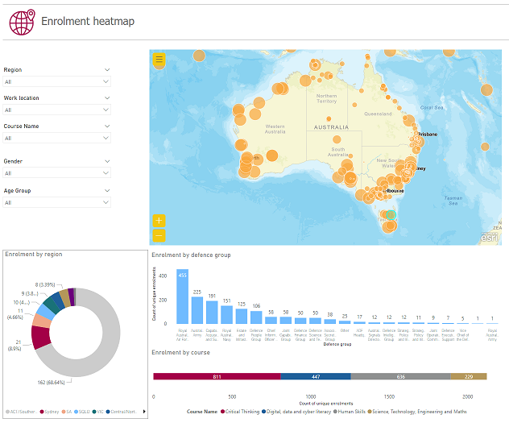
Phase 2 – MBS Build on You
Task 2.3
Build a ‘heat map’ of activity
Source: Enrolment_Data.csv
Working_location_coord_script.py
Task 2.3
Add a filter to this I.e. Look at group/level by location
Source: Enrolment_Data.csv

Slide 11
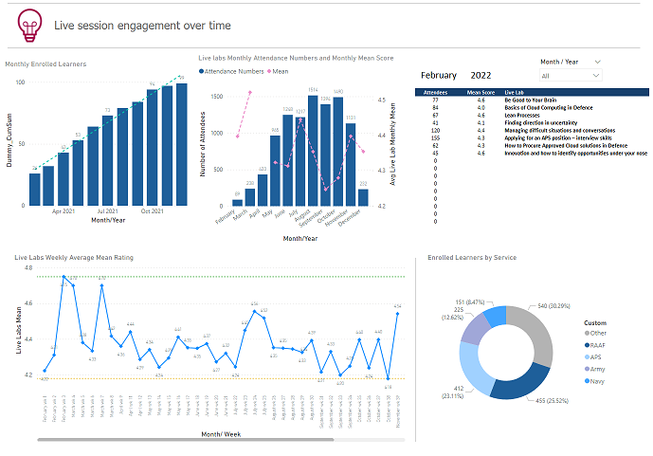
Phase 3 – MBS Build on You
2
*
Task 3.1
Change layout to be similar to DLB excel dashboard
Source: Enrolment_Data.csv
Source: Zoom_Poll_Template.csv
Zoom_Attendance.csv
Source: Zoom_Poll_Template.csv
Zoom_Attendance.csv
Source: Zoom_Poll_Template.csv
Source: Enrolment_Data.csv

Slide 12
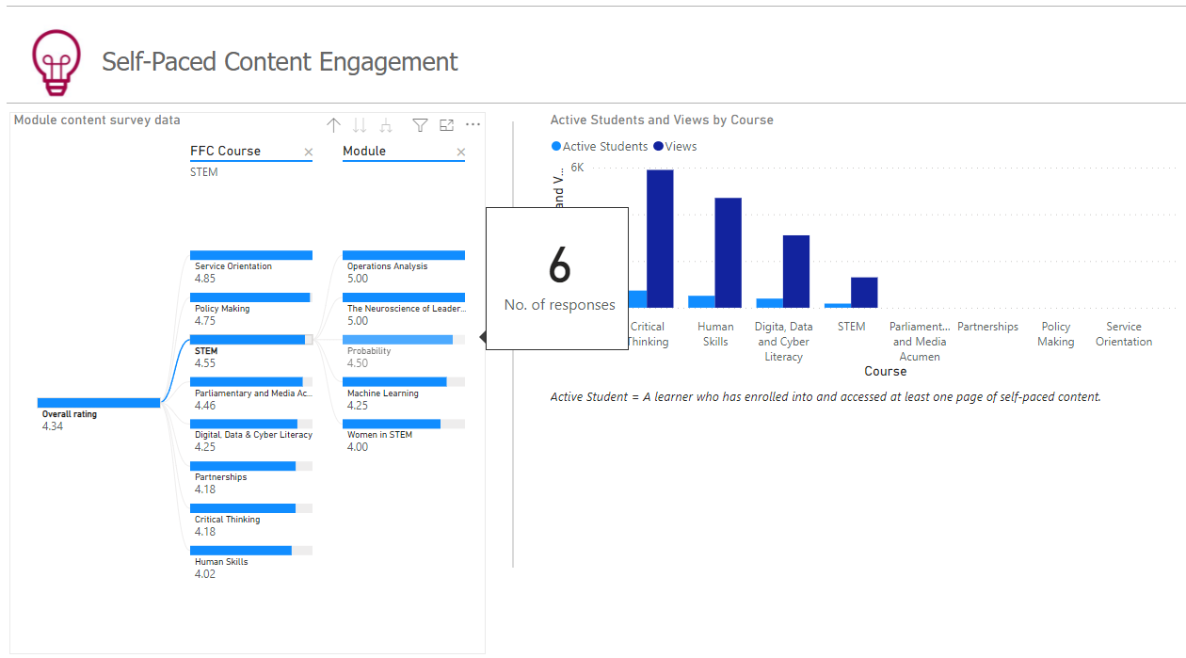
Phase 3 – MBS Build on You
Task 3.4
Build new section to show Module Content Survey Data
Task 3.4
Show Course & Module Name
Task 3.4
Show Mean Rating
Task 3.4
No. of Responses (on hover)
Source: BoY Module Content Survey Data as at 07022022.csv

Slide 13
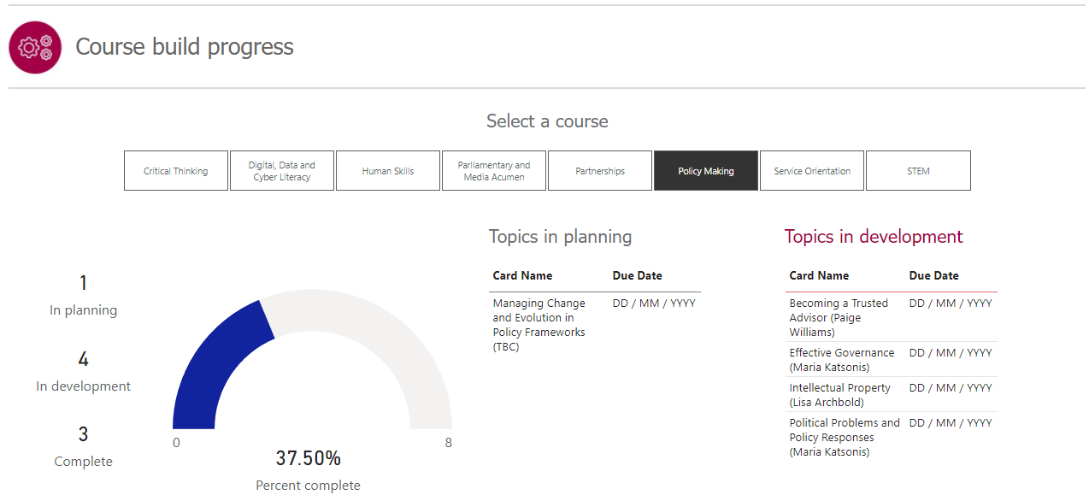
Phase 3 – MBS Build on You
Source: Course_Build_Data.csv
Task 3.5
Add field for “Expected Due Date” for topics currently in planning/development

